Slide 1
Micro-Frontends: An architectural pattern for building large-scale applications
Offering a level of decoupling never seen
Notes:
- Một mẫu kiến trúc để xây dựng các ứng dụng lớn, với nhiều thành viên và các nhóm độc lập khác nhau

Slide 2
Agenda
From monolith to micro
What are Micro-Frontends?
Micro-Frontend approaches
Which architecture fits your project?
Notes:
- Dịch chuyển từ mô hình khối tới micro

Slide 3

From monolith to micro…
EVERYTHING
Moving towards the micro-world!
Notes:
When your project is small, and you’re working with a handful of developers, building a web application is a straightforward task.
However, if your business has a large web application and wants to improve and add new features continually, a single team will quickly be overwhelmed.
This is where the micro frontend architecture comes in. There we slice the application into pieces that multiple teams can work on independently.

Slide 4

Scaling our application
Database
Database
Database
Database
Microservice
Microservice
Microservice
Monolith
API Gateway
SPA
SPA
Notes:
Usually when you have a start-up or greenfield project, we started in this way.
Let’s think about your business start to grow
All the effort is 99% of the time focused on the backend. Very rarely I see a lot of people spending time a huge amount of time architecturing the frontend.
Usually, you rely on own tools. But sometimes you need to think how you scale up

Slide 5
Impact within our teams
Frontend uses the same codebase for all the teams.
Communication overhead for managing different part of the UI.
Infrastructure, Microservices and Databases almost autonomous.
Database
Database
Database
Microservice
Microservice
Microservice
API Gateway
SPA
Notes:
We’re 10 developers, maybe distributed developers that is even more complicated. All of them they have to learn all your code convention, how to interpret the framework and lots of things around that.
You have some dependencies between the different teams.
Obviously, on the API side, we start to have interesting challenges and a lot of freedom because you can work within DDD style. You start to define subdomains, your bounded context, your own infrastructure, owned by one team. They can take their own decision, pick their own technolgoies autonomously. That starts to speed up the development.
Compared to the FE. They have to coordinate every time what they need to release.

Slide 6
Scaling our application with Micro-Frontends
Database
Database
Database
Microservice
Microservice
Microservice
API Gateway
API Gateway
Microfrontend
Microfrontend
Microfrontend
Routing
Notes:
What if we apply the same princicles that are on micro services and we apply on the frontend
You can do on the edge, for instance, Lamda@Edge for AWS
You can do server-side or client-side routing to load the right micro frontend at the right time

Slide 7
Impact within our teams
End to end autonomy within a business domain.
Freedom and responsibility.
Innovation without affecting the entire application.
Database
Database
Microservice
Microservice
API Gateway
Microfrontend
Notes:
They don’t have only our cross-functional teams. They design everything in the way they want, picking the right technologies. For example, one fully written in Vue.js, another micro-frontend is written in React.js. They’re not clashing together.
Each team can decide to use coding convention, best practice, own infrastructure and own backend.
They have the freedom to innovate. Sometimes we usually do a lot of technical updates.
You can fast iterate on delivering new functionalities without affecting the application

Slide 8
What are Micro-Frontends?
An architectural style where independently deliverable frontend applications are composed into a greater whole.
Each is the technical presentation of a business subdomain.
Allow for independent development of smaller, self-contained units.
Each team has a distinct area of business or mission.
Notes:
An architectural pattern for decomposing frontend monoliths into smaller, simpler chunks that can be developed, tested and deployed independently, while still appearing to users as a single cohesive product.
They offer many benefits such as development agility, technological freedom.
This approach enables teams to work independently on different parts of the application without affecting the entire system.

Slide 9
Benifits
Smaller, more cohesive and maintainable codebases
More scalable organizations with decoupled, autonomous teams
The ability to upgrade, update, or even rewrite parts of the frontend in a more incremental fashion than was previously possible
Notes:
It's easier to manage and maintain the codebase, as developers can focus on a specific functionality without being concerned with the rest of the application.
By allowing teams to work independently on their own micro-frontends, there is less need for coordination and dependencies between teams, leading to increased autonomy and faster development cycles.
By decoupling the front-end application into smaller units, it's easier to scale the application as it grows in size and complexity.

Slide 10
Downsides
Increased complexity
Integration challenges
Performance considerations
Testing and debugging
Notes:
Increased complexity: - While micro-frontends can help to simplify the codebase for individual teams, the overall architecture of the application can become more complex, as there are now multiple components that need to be integrated together at runtime.
Integration challenges: - Ensuring that the different micro-frontends work together seamlessly can be a challenge, as there may be differences in technology stacks, libraries, and frameworks used by the different teams.
Performance considerations: - With multiple micro-frontends being loaded and integrated, there may be performance considerations to take into account, such as the time it takes to load and render the different components.
Testing and debugging: - As there are now multiple components that need to be tested and debugged separately before they are integrated together.
When one team has put in the work to make their build process twice as fast, the other teams don’t automatically benefit from this change. This team has to share this information with the others. The other teams have to implement the same optimization on their own.

Slide 11
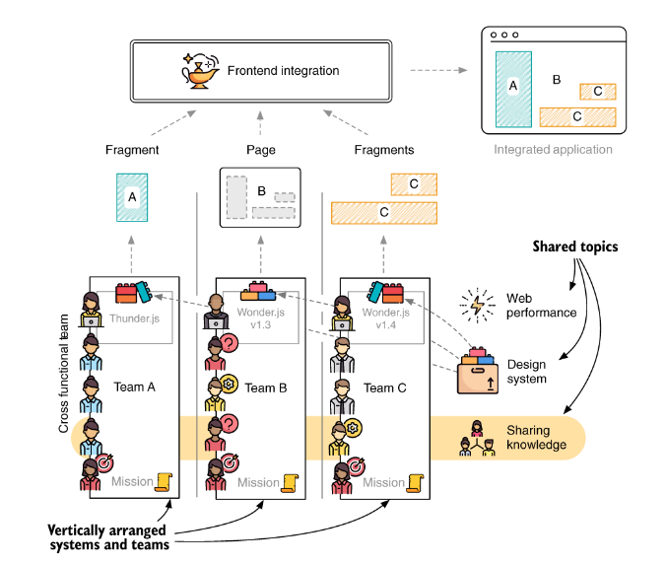
Why companies adapt a MFs architecture
Optimize for feature development
Make frontend upgrades easier
Scalable development
Increase customer focus
Notes:
Optimize for feature development
A team includes all skills needed to develop a feature. No coordination between separate frontend and backend teams is required. The micro frontend architecture optimizes for implementing features by moving all necessary people closer together
Make frontend upgrades easier
Teams can decide to update or switch their frontend technology independently.
Scalable development
This allows us to quickly scale development by spinning up new teams to deliver additional frontend functionality via child applications.
Increase customer focus
Every team ships their features directly to the customer. No pure API teams or operation teams exist.
Each system is autonomous, which means it can function even when the neighboring systems are down

Slide 12
When do Micro-Frontends make sense?
Good to medium-to-large projects
Works best on the web
Productivity over overhead
Notes:
The Two-Pizza Team Rule suggested by Amazon CEO Jeff Bezos. It says that a team is too big when two large pizzas can’t feed it. The perfect size is 5 – 10 people
You have to build a single application bundle that’s then submitted to Apple’s or Google’s review process. A way around this is to load parts of the application from the web. Embedded browsers or WebViews can help to keep the native part of the app to a minimum.
The developer experience dramatically improved with frontend developers using frontend-familiar technologies. The time-to-deploy of frontend changes were remarkably reduced

Slide 13
Micro-Frontend approaches
Separate pages
Iframes
Ajax
Server-side composition
Client-side composition
Universal composition (client- and server-side composition)

Slide 14
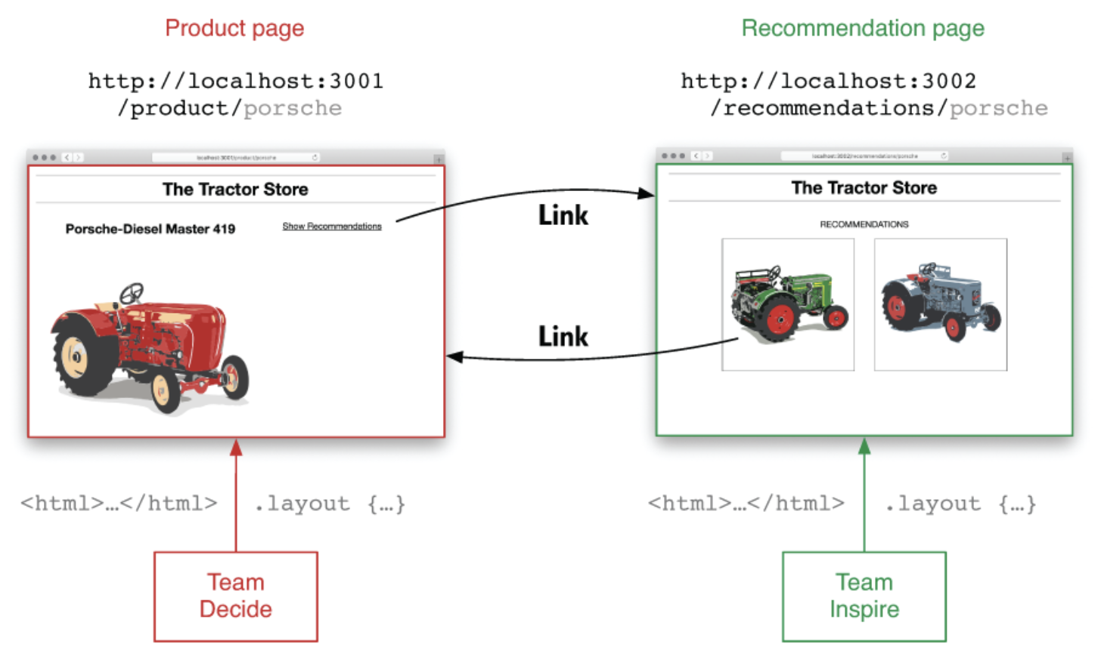
Separate pages
Notes:
Team Inspire’s mission, as the name implies, is to inspire the browsing customer and to present products that might be of interest.
Team Decide helps in making an informed buying decision by providing excellent product images, a list of relevant specs, comparison tools, and customer reviews.
Team Checkout takes over when the customer has decided on an item and guides them through the checkout process.
Team Decide doesn’t have to know anything about these relations. Nor do they need to know about the underlying algorithms and data sources.
The coupling between the two applications is low, and the robustness is high
With this simple integration, we have no way of combining data from two different teams into one view.
This model also comes with a lot of technical redundancy and overhead. Common parts like the page header need to be created and maintained by each team.

Slide 15
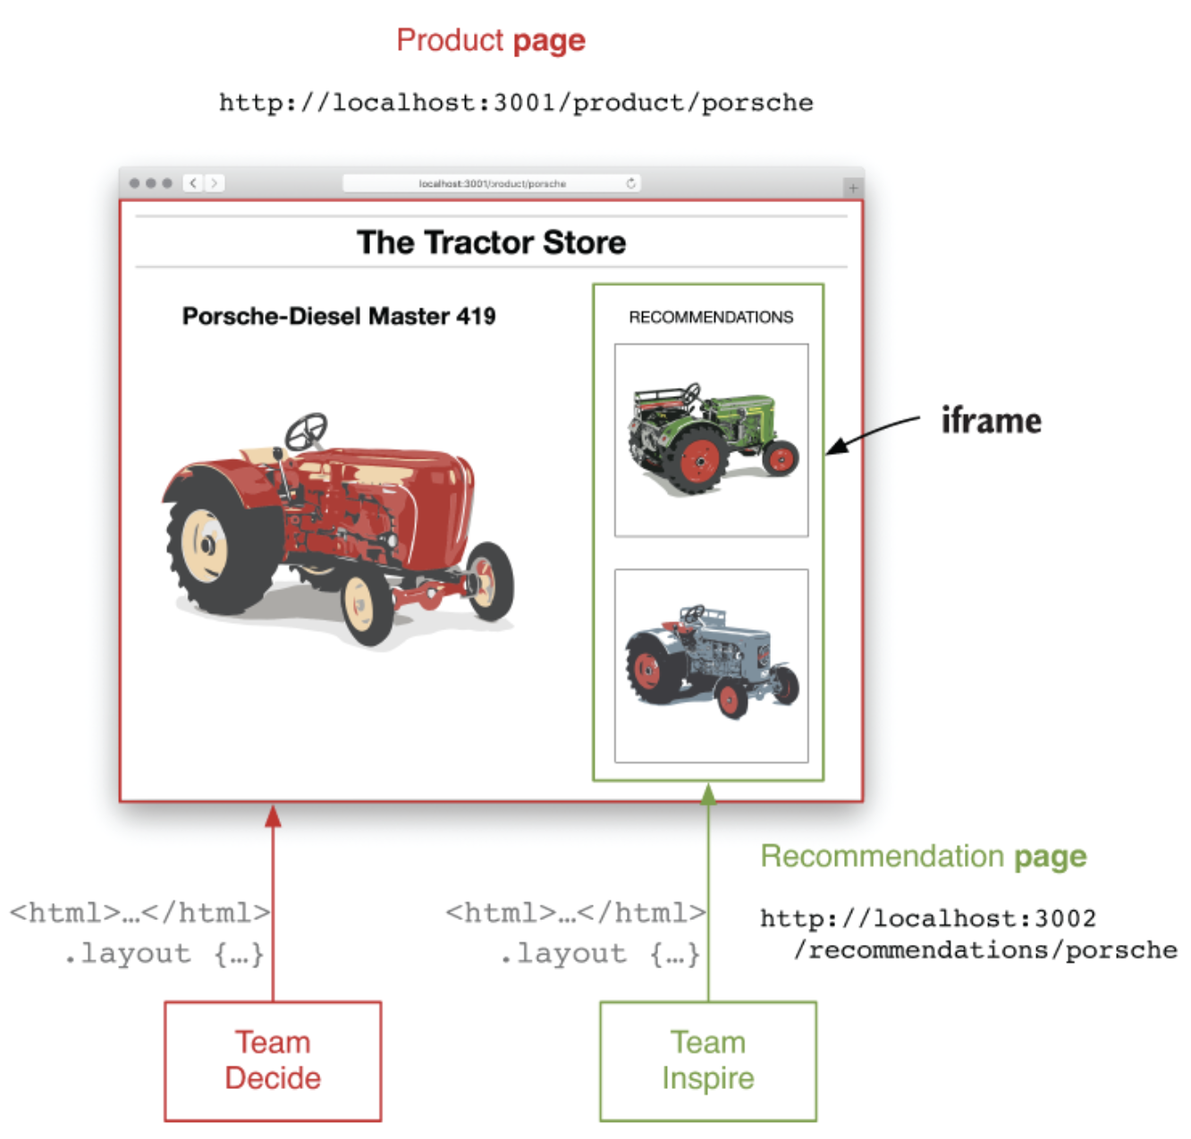
Iframes
Notes:
Discovering new tractors via the Show Recommendations link works, but is not obvious enough for the customer
It’s possible to embed one page into another page while maintaining the same loose coupling and robustness properties that the link integration provides. Iframes come with strong isolation
Iframes have one major drawback when it comes to layout. The outer document needs to know the exact height of the iframe’s content to avoid scrollbars or whitespace
There’s a JavaScript libraries exist to automatically update the iframe size when its content changes.
The iframe is the optimal composition technique for micro frontends. Iframes work in every browser. They provide strong technical isolation. Scripts and styles can’t leak in or out.
The drawbacks:
Performance overhead
Bad for accessibility
BAD for Search engines

Slide 16
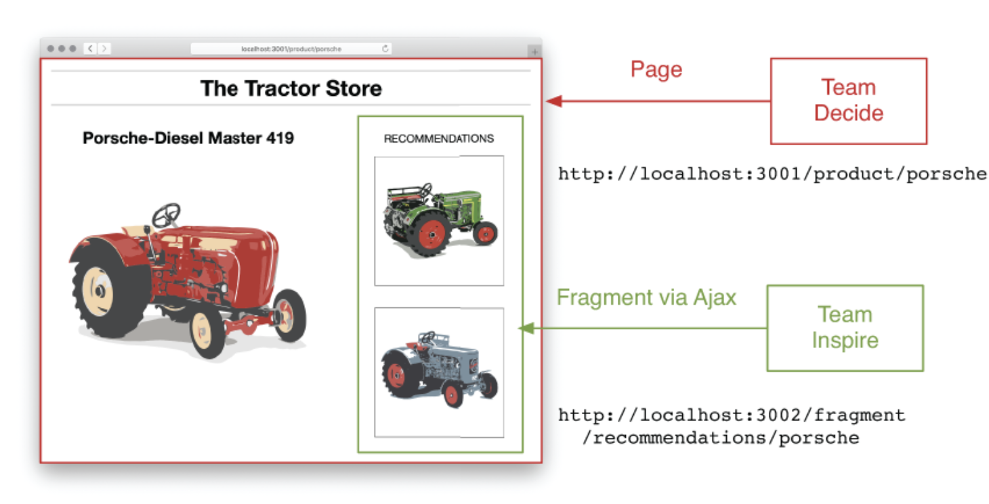
Ajax

Slide 17
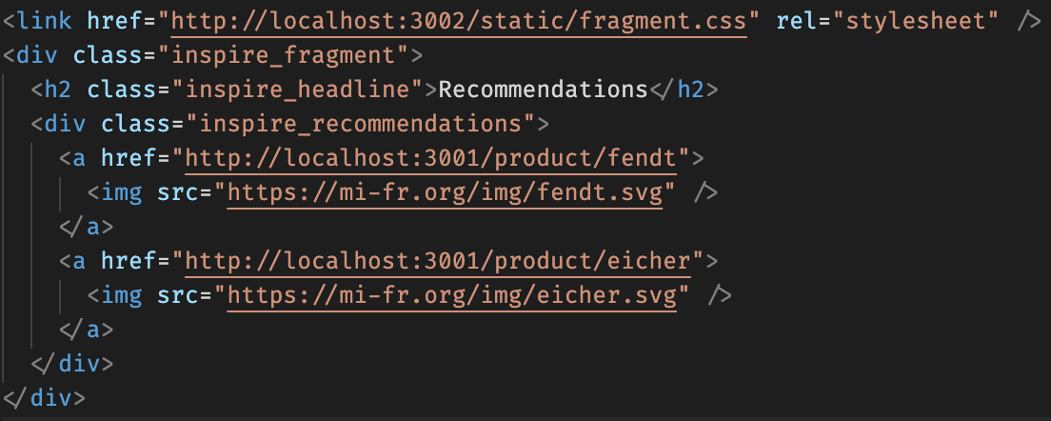
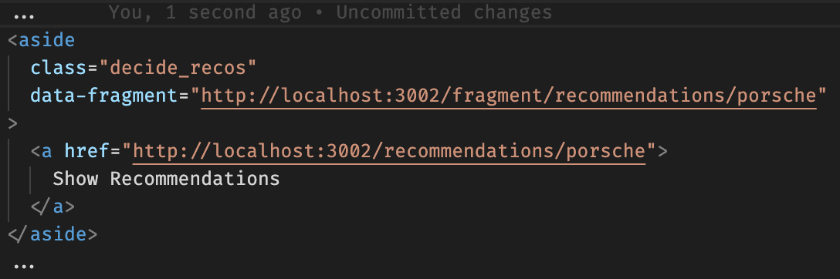
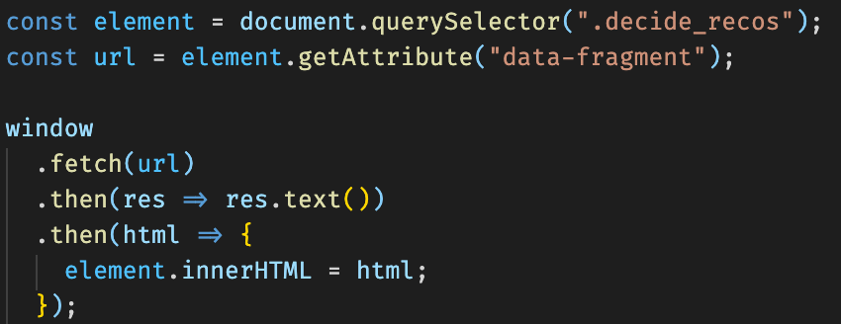
Composition via Ajax
Fragment markup
Page markup
Ajax request from Page
Notes:
- Namespacing styles and scripts
It’s a good idea to introduce an extra team-level prefix or CSS Modules, CSS-in-JS
Cookies, storage, events, or unavoidable global variables should be namespaced
document.cookie = "decide_optout=true";
localStorage["decide:last_seen"] = "a,b";
sessionStorage["inspire:last_seen"] = "c,d";
Drawbacks
Asynchronous loading causes delay
Missing isolation

Slide 18
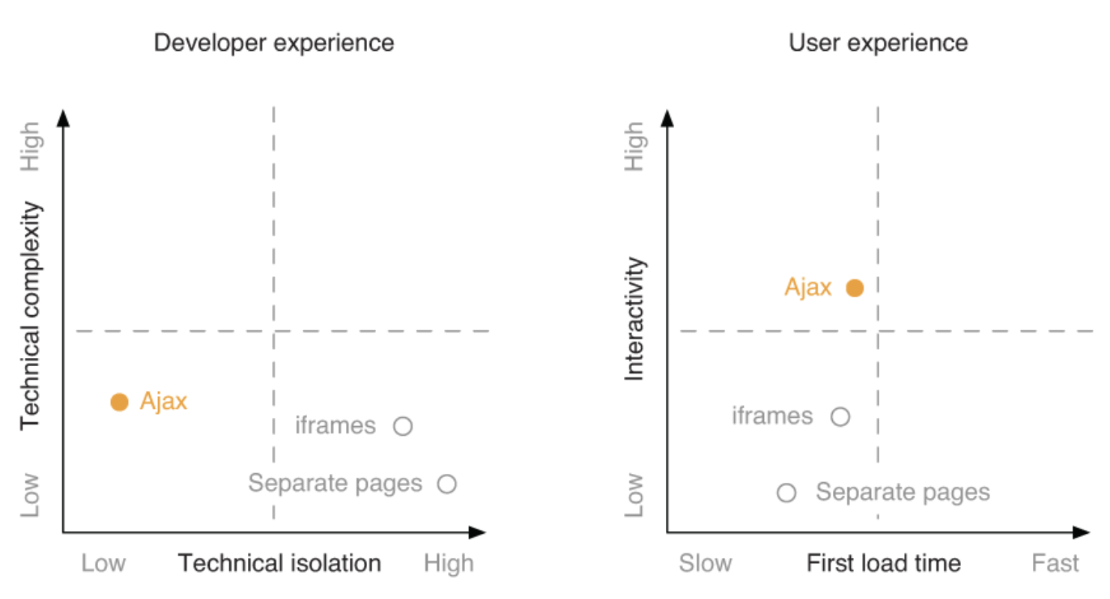
The page links, iframe, and Ajax approach compared to each other
Notes:
Technical complexity describes how easy or complicated it is to set up and work in a model like this.
Technical isolation indicates how much native isolation you get out of the box.
Interactivity says how well this method is suited for building applications that feel snappy and respond to user input quickly.
First load time describes the performance characteristics. How fast does the user get to the content they want to see?

Slide 19
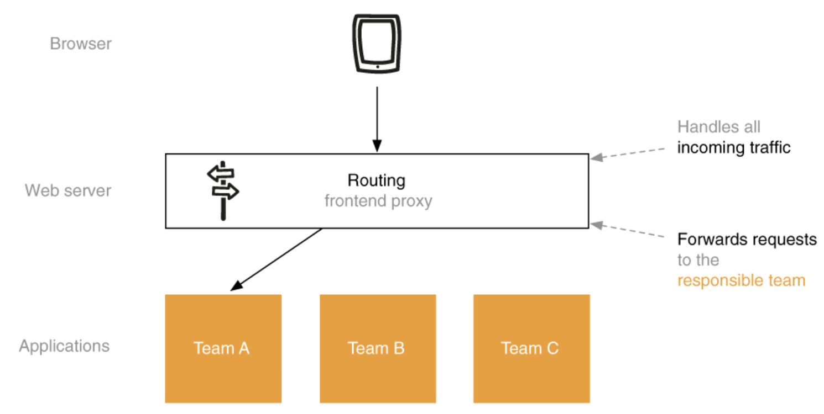
Server-side routing
Notes:
The company’s web properties should be accessible from one domain
The shared web server is inserted between the browser and the team applications. It acts as a proxy and forwards the requests to the responsible teams.
Each team should receive its own path prefix. The frontend proxy should route all requests starting with /decide/ to Team Decide’s server, /product/ to Team Decide, /recommendations/ go to Team Inspire

Slide 20
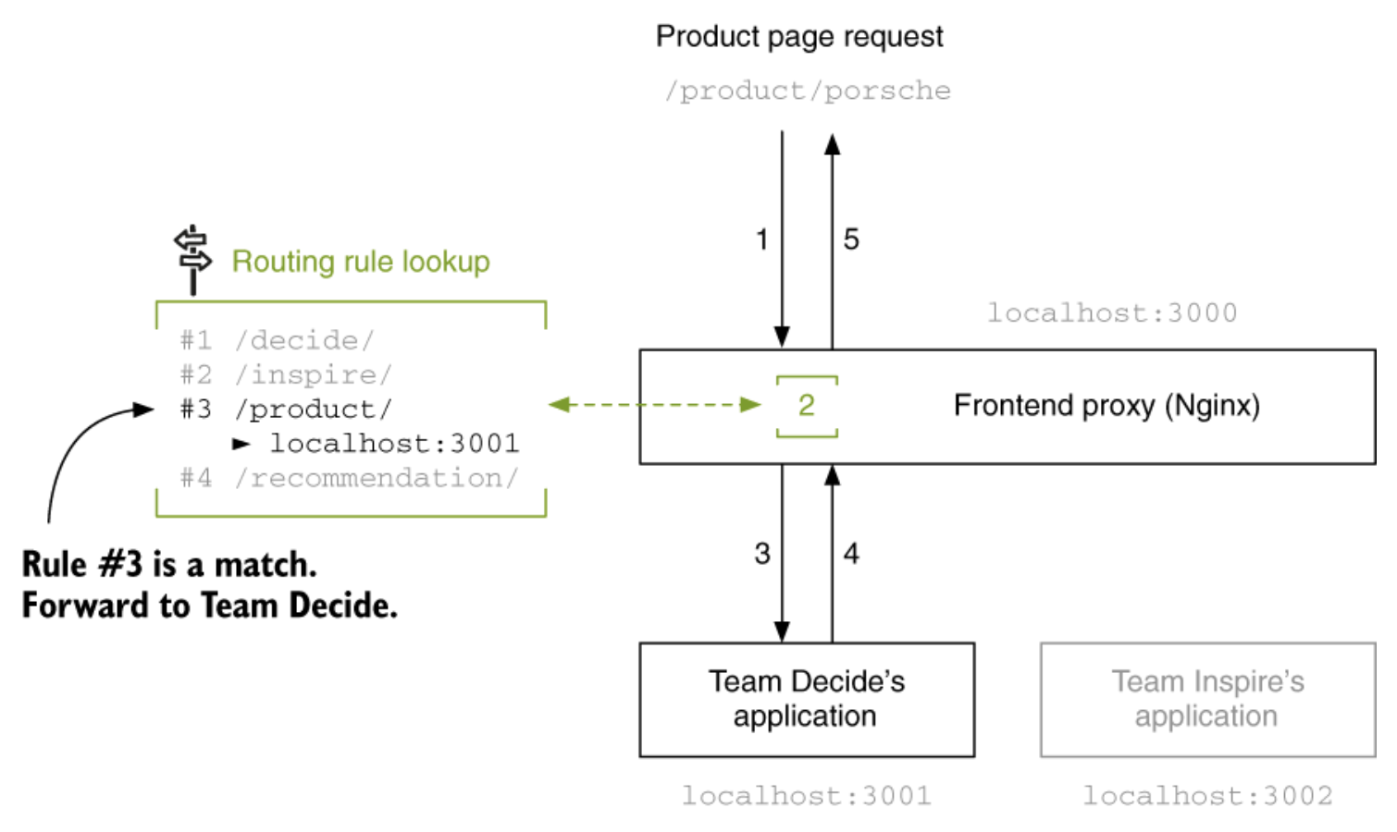
Frontend proxy
Rule # | Path prefix | Team | Application
per team prefixes (default)
#1 | /decide/ | Decide | localhost:3001
#2 | /inspire/ | Inspire | localhost:3002
per page prefixes (additional)
#3 | /product/ | Decide | localhost:3001
#4 | /recommendations/ | Inspire | localhost:3002
Notes:
- Flow of a request. The frontend proxy decides which application should handle an incoming request. It decides based on the URL path and the configured routing rules

Slide 21
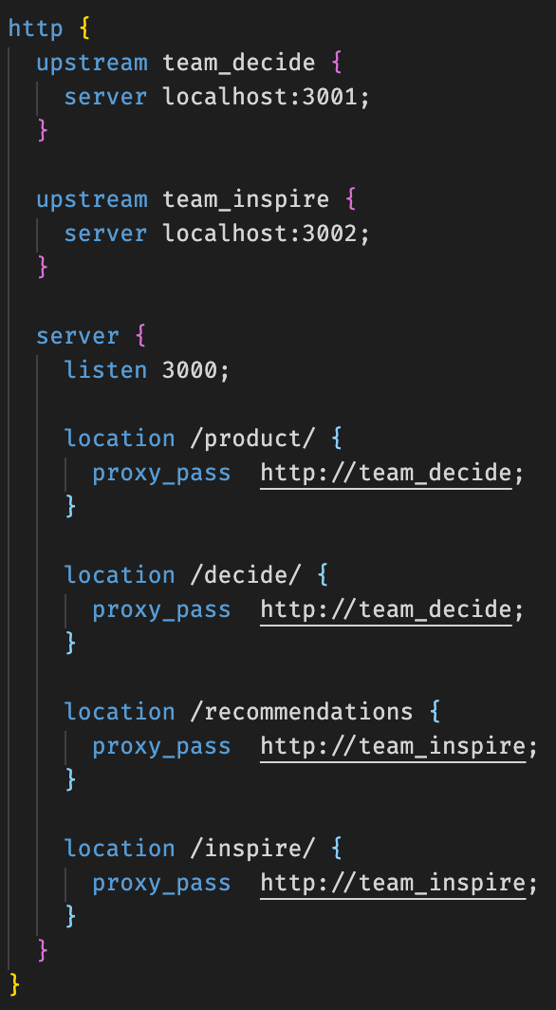
How to configure Frontend proxy
Page | Old | New
Product | http://localhost:3001/product/<sku> | /product/<sku>
Recommendation | http://localhost:3002/recommendations/<sku> | /recommendations/<sku>
Recommendation fragment | http://localhost:3002/fragment/recommendations/<sku> | /inspire/fragment/recommendations/<sku>
Route configuration
1. Page-specific routes (like /product/)
2. Team-specific routes (like /decide/)
Notes:
Forwarding a request to another server (proxy_pass/upstream)
Differentiating incoming requests (location)
Namespacing resources
When your project grows, the number of entries in the routing configuration also grows. It can get complicated quickly. There are different ways to deal with this complexity.

Slide 22
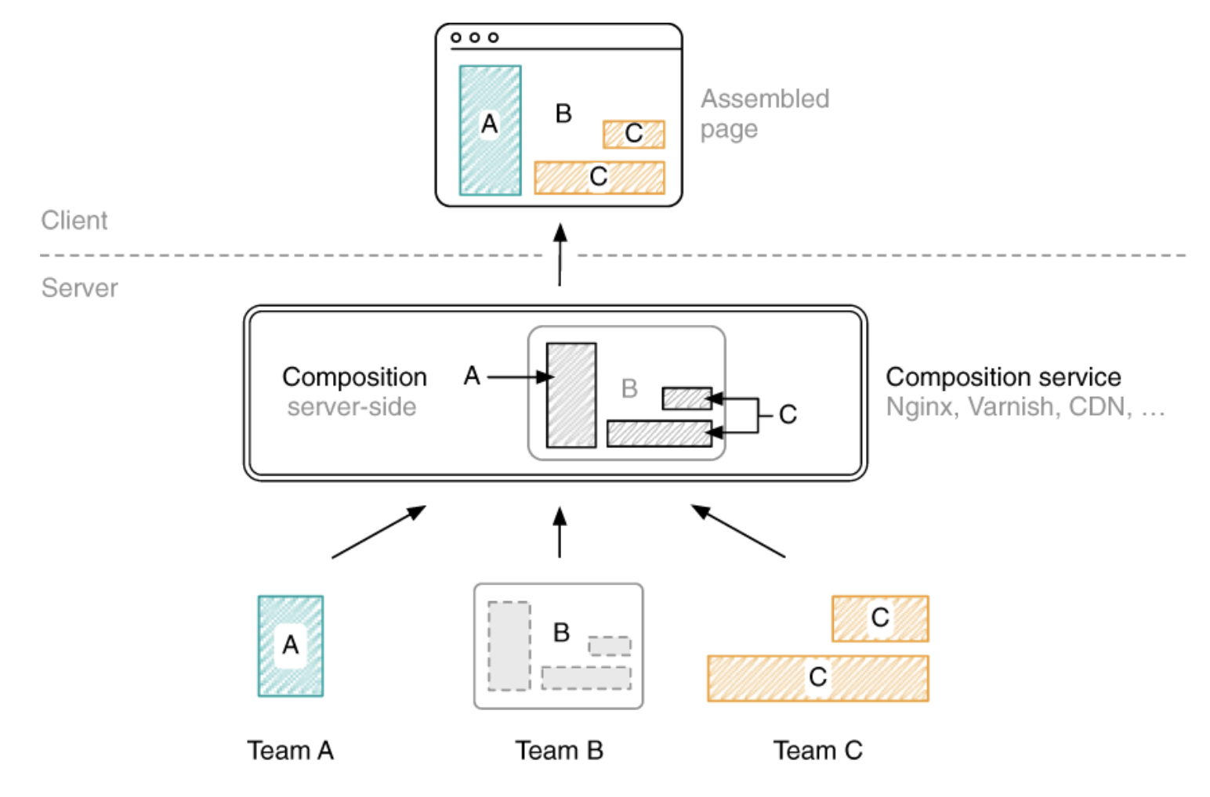
Server-side composition
Notes:
Assembling the markup of different fragments on the server is a widespread and popular solution
Many e-commerce companies like Amazon have chosen this way
Composition of fragments happens on the server. The client receives an already assembled page
You can achieve incredibly good first-page load speeds

Slide 23
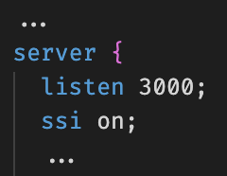
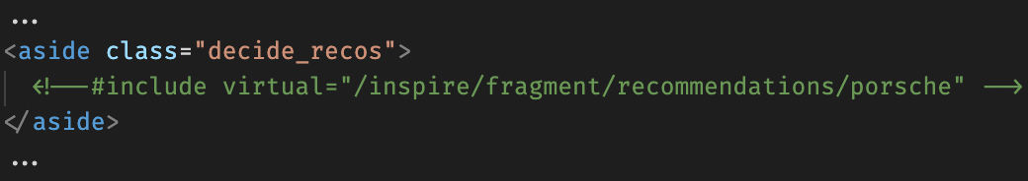
Composition via Nginx and Server-Side Includes (SSI)
1. Activate Nginx’s SSI support in the web server’s configuration.
2. Add an SSI directive to their product template. The SSI’s URL must point to an existing endpoint.
Notes:
To overcome elements like the recommendation strip appear with a noticeable delay.
The developers are surprised by the poor performance reports. On their machines, all pages load pretty quickly. They can’t even see the effects that the customers described on their machines. But this might be because their customers don’t own $3,000 notebooks, aren’t on a fiber connection, and don’t live in the same country where the datacenter is located.
Server Side Include is server side interpreted scripts language. It mostly used in web. Use of SSI is to include a file into web page.
The web server replaces this directive with the contents of the referenced URL before it passes the markup to the client.

Slide 24

Server-side composition in the application

Slide 25
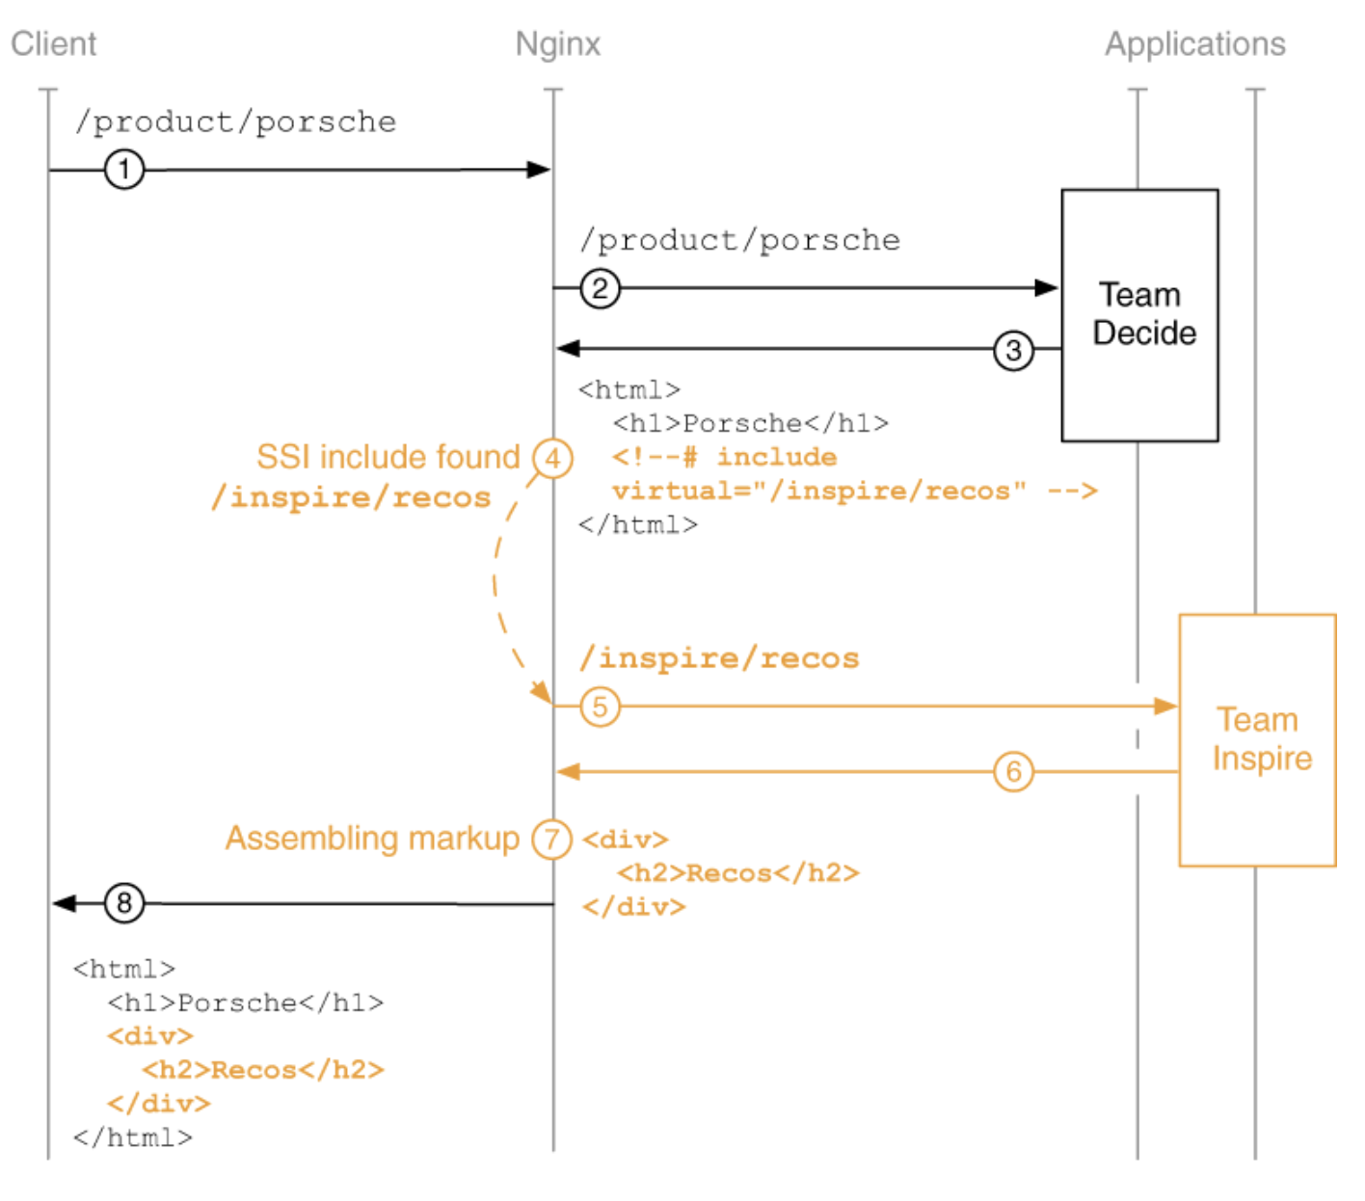
How SSI works
Notes:
The client requests /product/porsche.
Nginx forwards the request to Team Decide because it starts with /product/.
Team Decide generates the markup for the product page, including an SSI directive where the recommendations should be placed, and sends it to Nginx.
Nginx parses the response body, finds the SSI include, and extracts the URL (virtual).
Nginx requests its content from Team Inspire because the URL starts with /inspire/.
Team Inspire produces the markup for the fragment and returns it.
Nginx replaces the SSI comment on the product page’s markup with the fragments markup.
Nginx sends the combined markup to the browser.

Slide 26
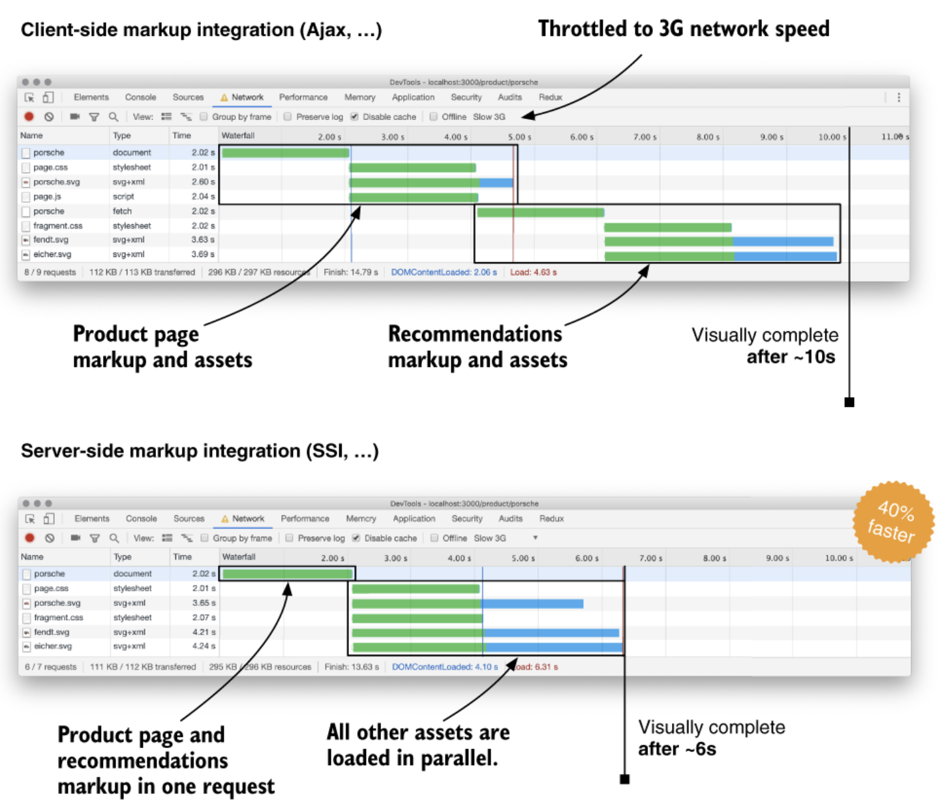
Better load times
Notes:
Integrating markup on the server usually leads to better page load performance because latency inside the datacenter is much shorter than to the client.
If you are building a large, fully server-rendered page, you might get a non-optimal time to first byte, and the browser spends a lot of time downloading markup instead of loading necessary assets like styles and images for the viewport
Use server-side integration where it makes sense and combine it with client-side integration when needed.

Slide 27
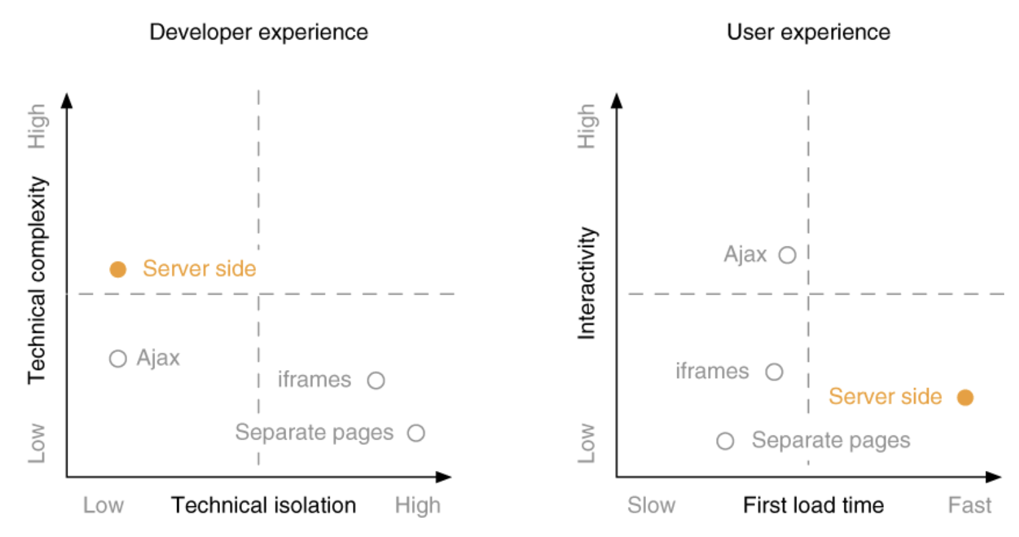
Server-side integration in comparison to other integration techniques
Notes:
- Server-side integration introduces extra infrastructure, which increases complexity. Similar to the Ajax approach, they don’t introduce technical isolation. You still have to rely on manual namespacing. But they enable you to achieve good page load times.

Slide 28
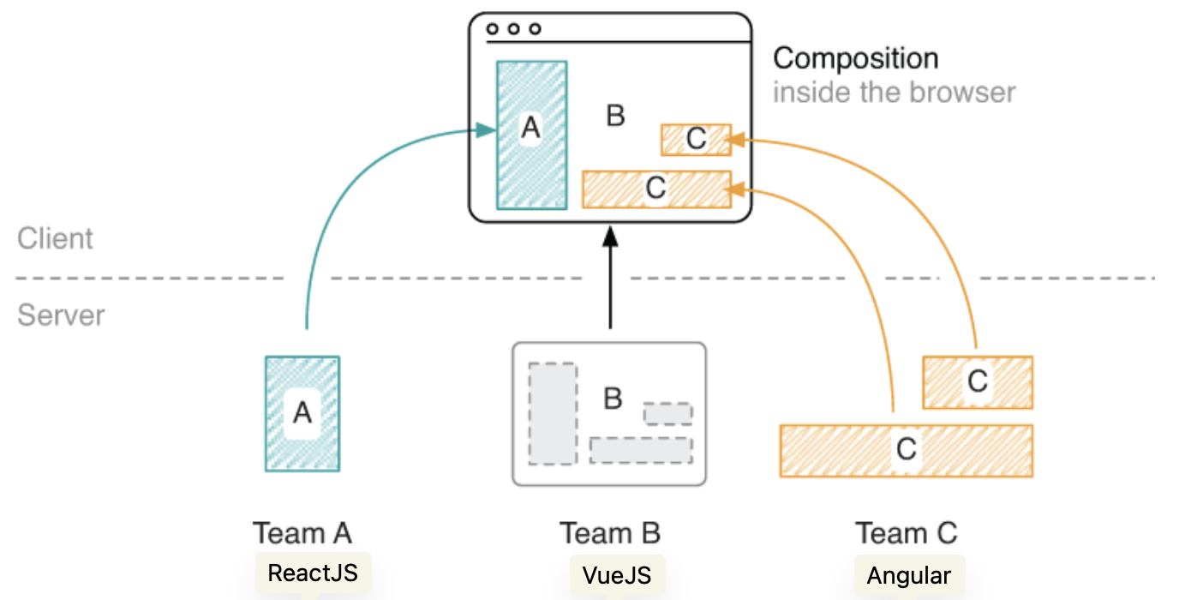
Client-side composition
Notes:
Micro frontend composition in the browser. Each fragment is its own mini-application and can render and update its markup independently from the rest of the page

Slide 29
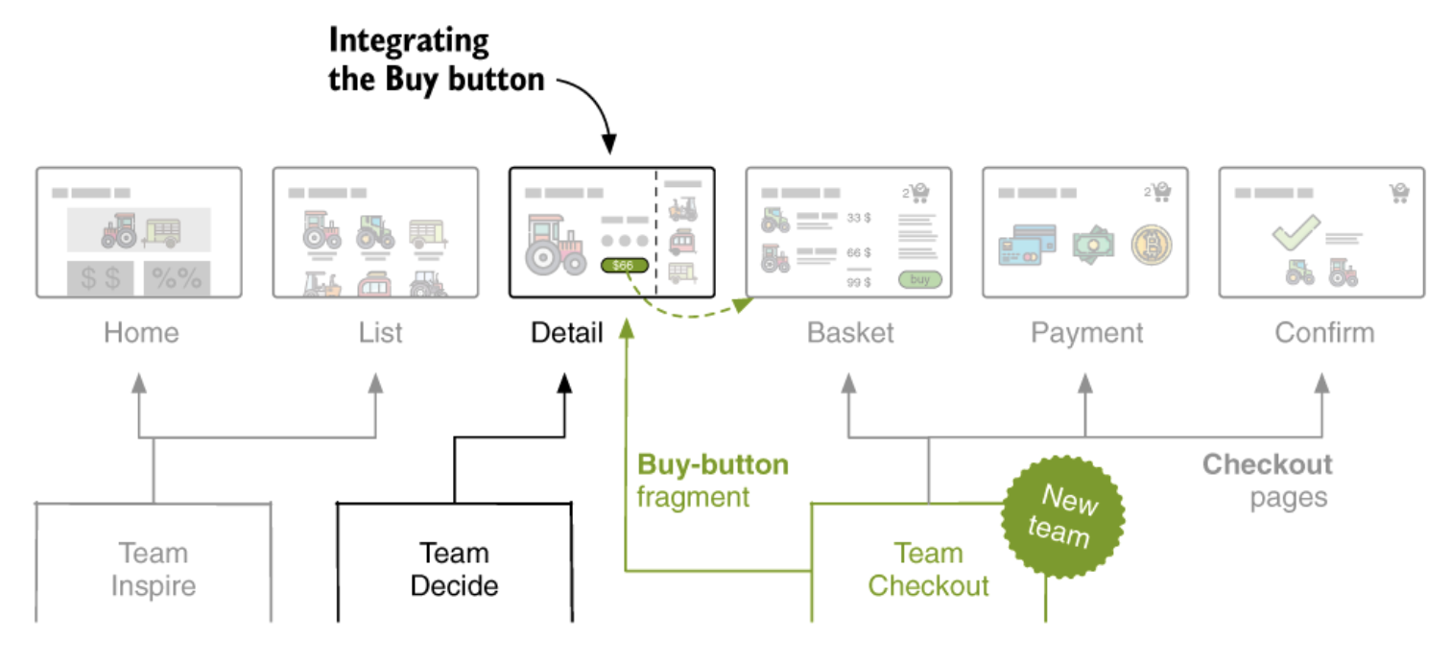
Wrapping Micro-Frontends using Web Components
Notes:
- Recently, the company staffed a third team: Team Checkout. They have been working hard to set up the infrastructure and write the software for handling payments, storing customer data, and talking to the logistics system
- Team Checkout chose to go with client-side rendering for their user interfaces. They’ve implemented the checkout pages as a single page app (SPA). The Buy-button fragment is available as a standalone Web Component

Slide 30
The contract between both teams
1. Buy button
tag-name: checkout-buy
attributes: sku=[sku]
example: <checkout-buy sku="porsche"></checkout-buy>
2. Required JS & CSS assets references
http://localhost:3003/static/fragment.css
http://localhost:3003/static/fragment.js

Slide 31
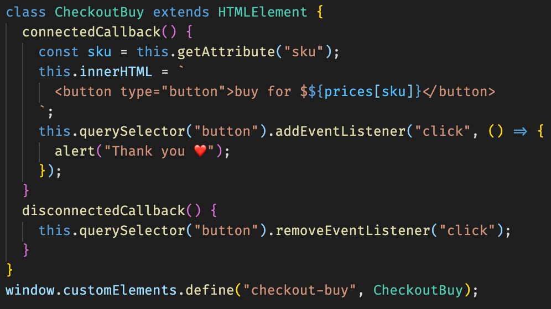
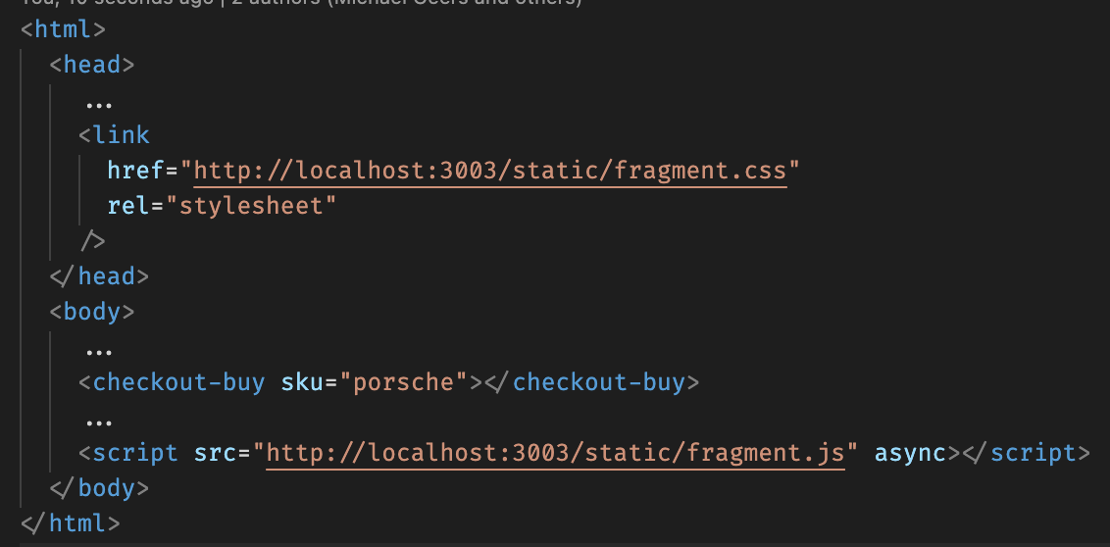
Composition via Web Components
Notes:
Team Checkout is free to change its implementation in the future without having to coordinate with Team Decide
The Web Components spec has been a long time in the making. Its goal is to introduce better encapsulation and enable interoperability between different libraries or frameworks

Slide 32
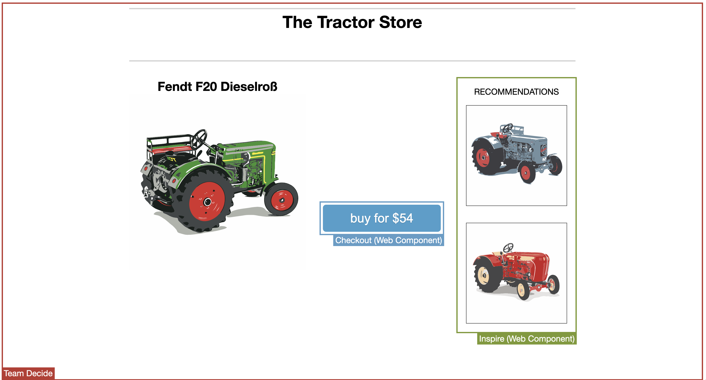
Client-side composition using Web Components in the application

Slide 33
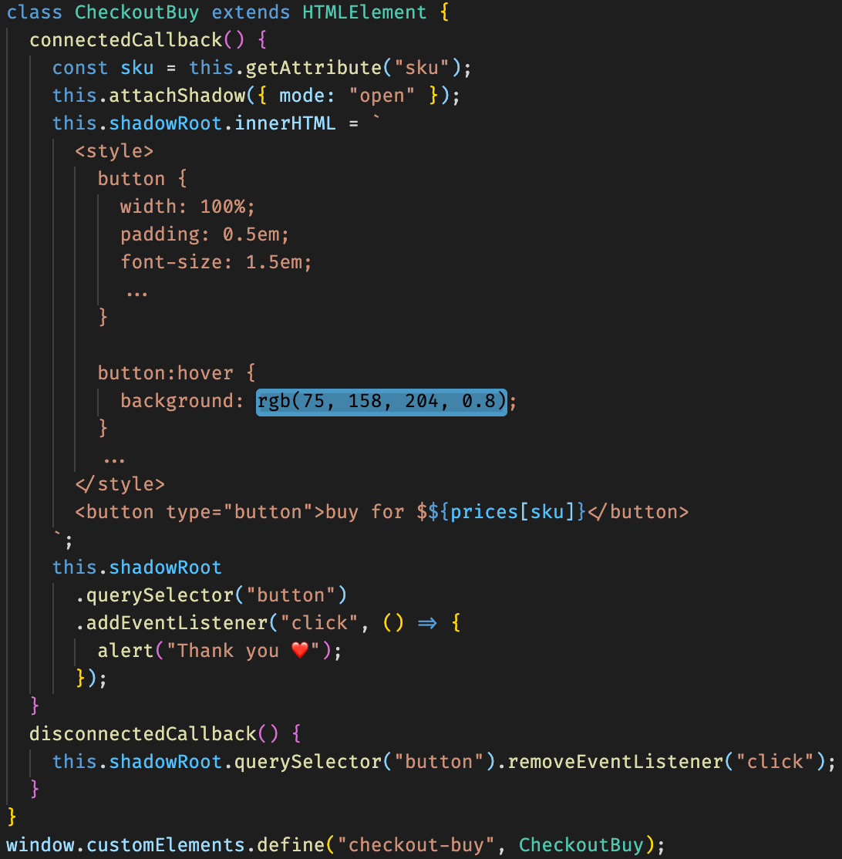
Style isolation using Shadow DOM
Notes:
We can use it to eliminate the chance of leaked styles, and thereby increase the robustness of our micro frontend applications.
Currently, Team Checkout’s fragment.css file is included globally in the head. All styles in this file have the potential to affect the complete page. Teams have to adhere to CSS namespacing rules to avoid conflicts
Prevents global styles from leaking into a micro frontend. Great when working with legacy applications.

Slide 34
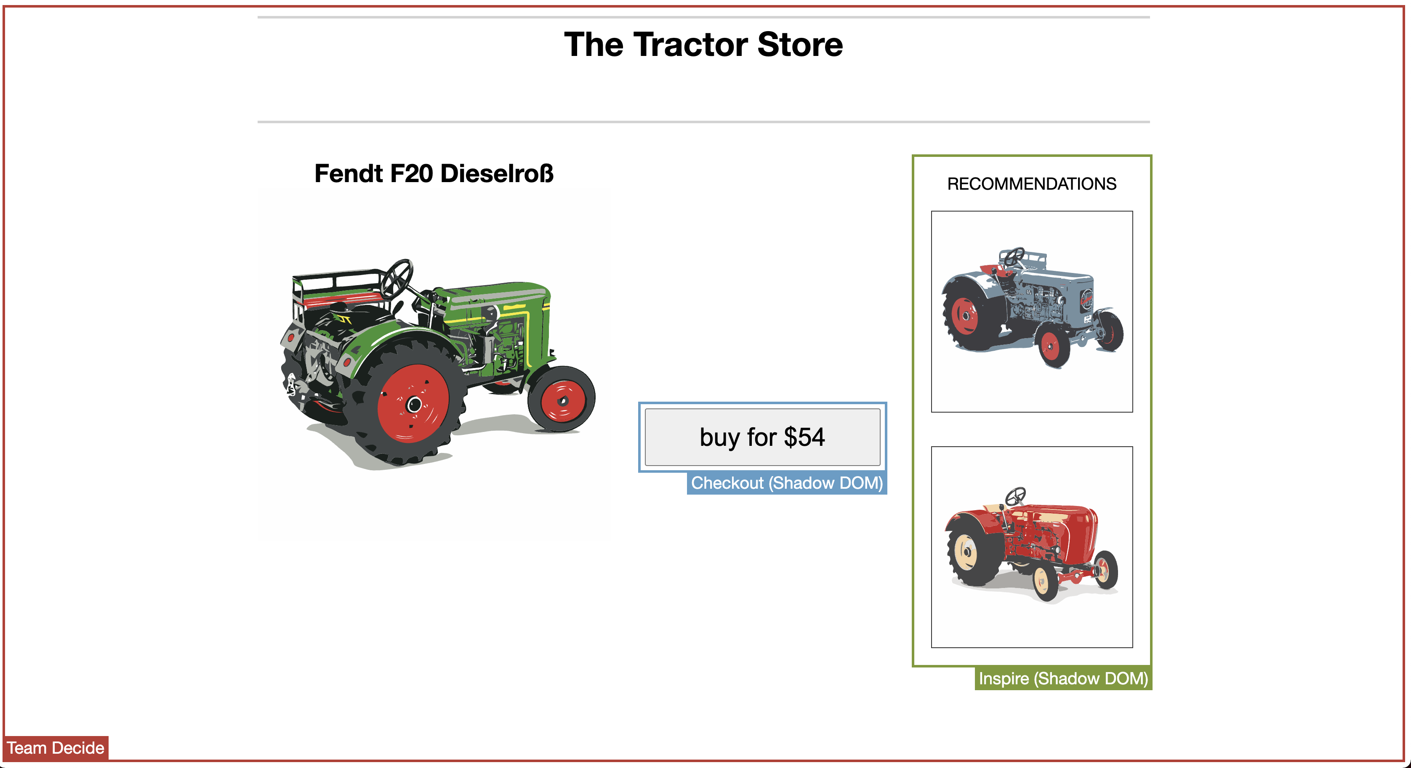
Style isolation using Shadow DOM in the application

Slide 35
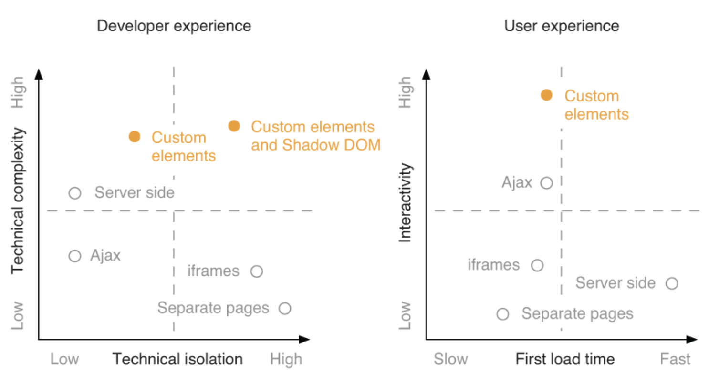
Web Components in comparison to other integration techniques
Notes:
Custom Elements provide a good way to encapsulate your JavaScript application
Shadow DOM introduces an extra isolation mechanism and lowers the risk of conflicts
Shadow DOM not only prevents styles from leaking out--it also guards against global styles leaking in. This styling boundary makes it an excellent fit for integrating a micro frontend into a legacy application.
You can build highly interactive, client-side rendered applications using Custom Elements. But since they require JavaScript to function, a server-rendered solution will usually be quicker on the first load

Slide 36
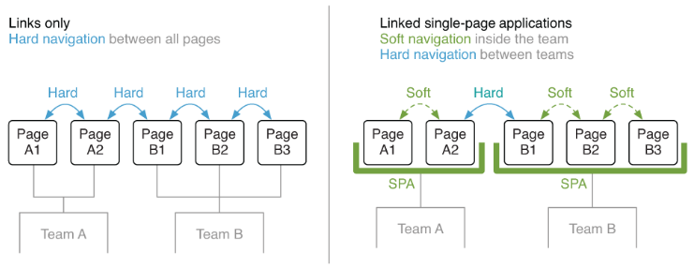
Client-side routing and the application shell
Notes:
We’ll take a step back and look at page-level integration.
Most JavaScript frameworks come with a dedicated routing solution like @angular/router, react-router or vue-router. They make it possible to navigate through different pages of an application without having to do a full page refresh
Hard navigation describes a page transition where the browser loads the complete HTML for the next page from the server.
Soft navigation refers to a page transition that’s entirely client-side rendered, typically by using a client-side router

Slide 37
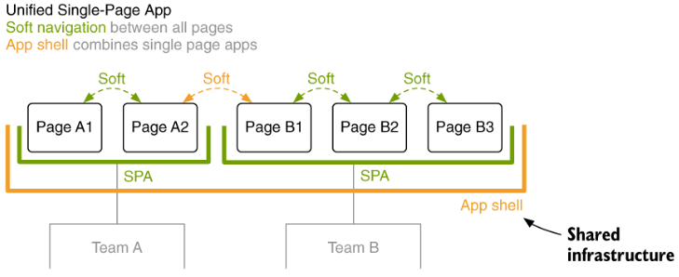
Unified Single-Page Application
Notes:
It introduces a central application container. It handles page transitions between the teams
We need to establish a new shared piece of infrastructure: an app shell. Its job is to map URLs to the correct team

Slide 38
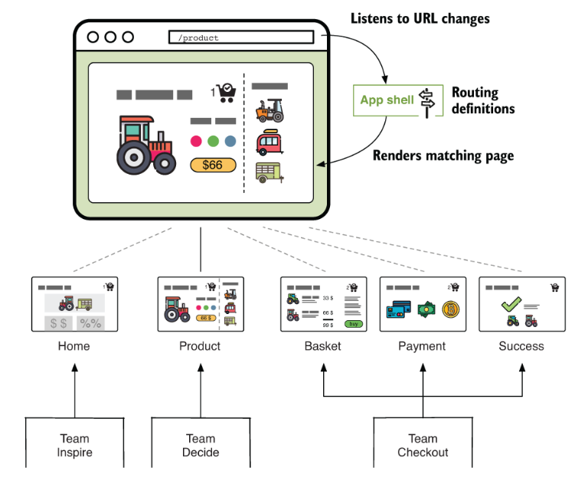
The app shell
Notes:
It watches for URL changes, determines the matching page (micro frontend), renders it, and (de)initializes the previous/next page on navigation
It should not contain any business logic. Sometimes topics that affect all teams, like authentication or analytics, are also built into the app shell

Slide 39
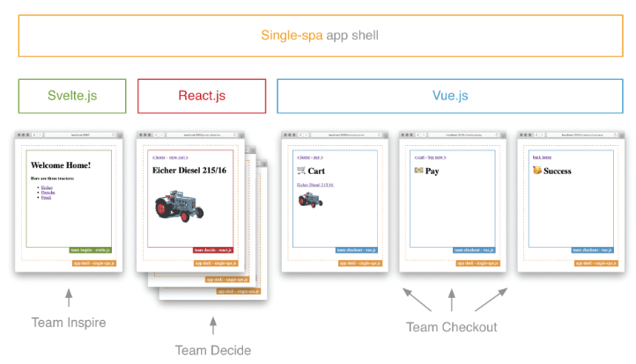
Single-spa app shell
Notes:
“single-spa” A javascript router for front-end microservices
Use multiple frameworks in a single-page application, allowing you to split code by functionality
Makes them work together and won't load them until they're needed.

Slide 40
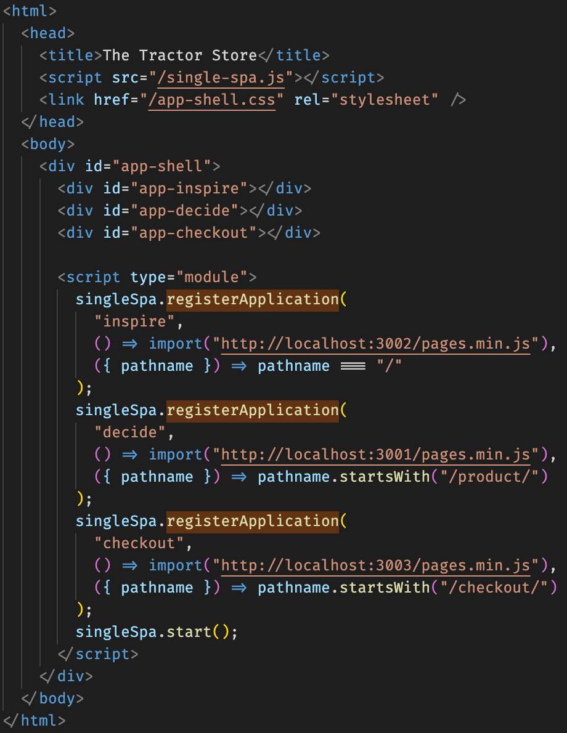
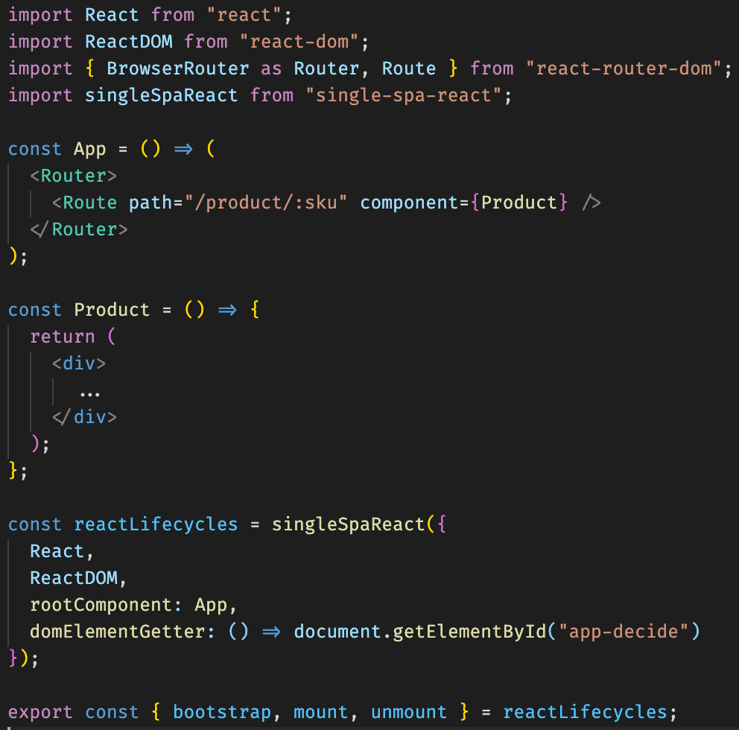
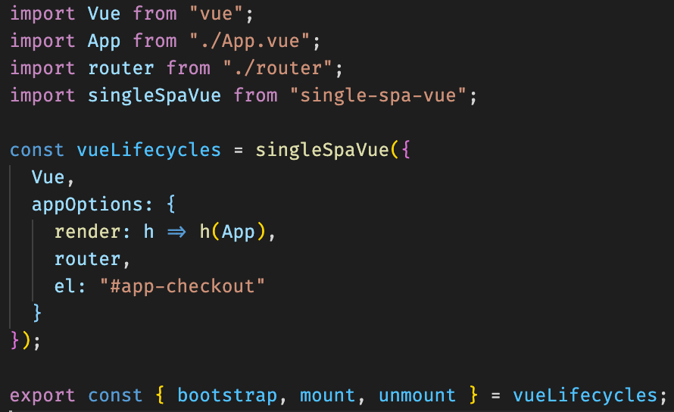
Composition via single-spa app shell
Notes:
“single-spa” calls bootstrap when a micro frontend becomes active for the first time. It invokes (un)mount every time the application is (de)activated.

Slide 41
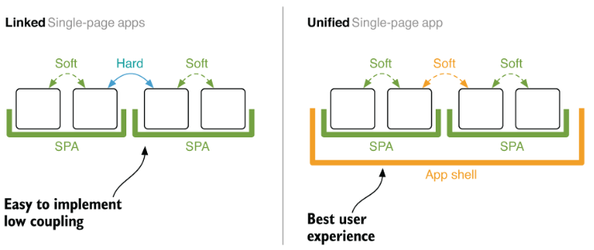
Unified single-app app tradeoff
Notes:
This model plays to its strength when the user needs to switch frequently between user interfaces owned by different teams. In e-commerce, the jump between the search result and the product details page
This approach does not come for free and introduces a considerable amount of shared complexity.

Slide 42
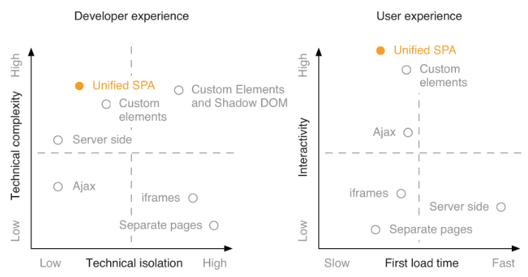
Unified SPA in comparison to other integration techniques

Slide 43
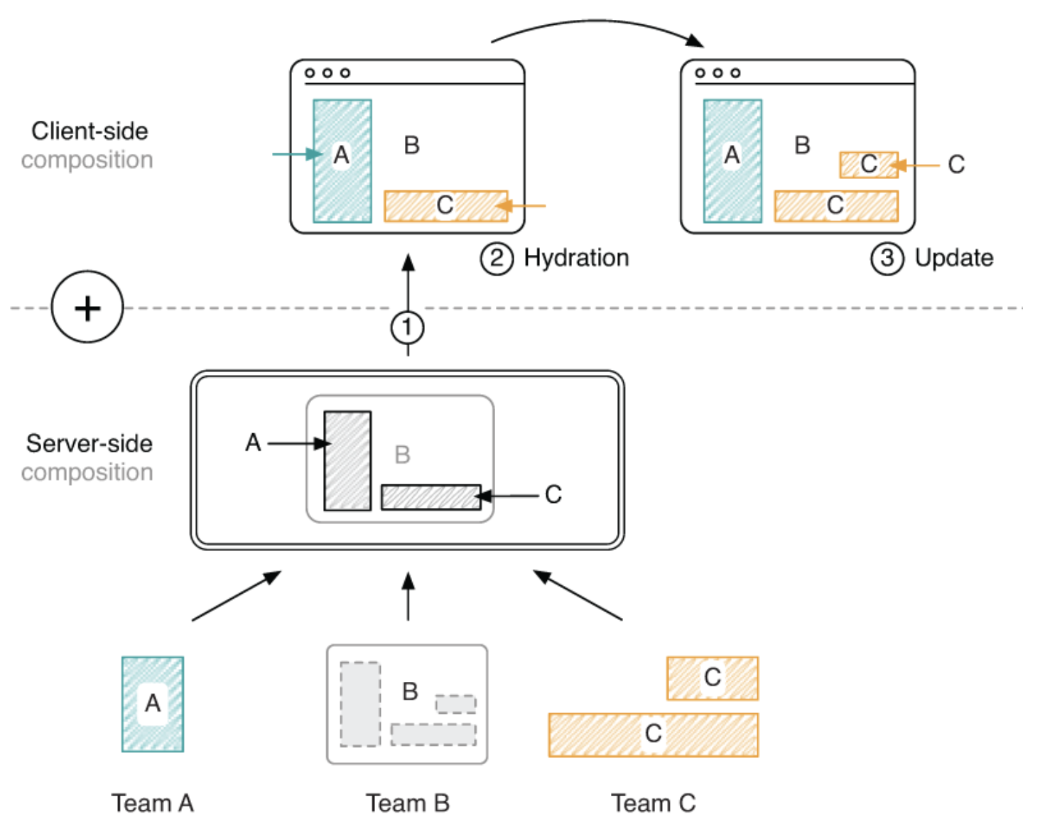
Universal composition
Notes:
- Universal rendering combines the benefits of server and client rendering: fast first-page load and quick response to user input and your use case requires communication between the different micro frontends
- Setting up, running, and debugging a universal application is more complicated than having a pure client- or server-side solution

Slide 44
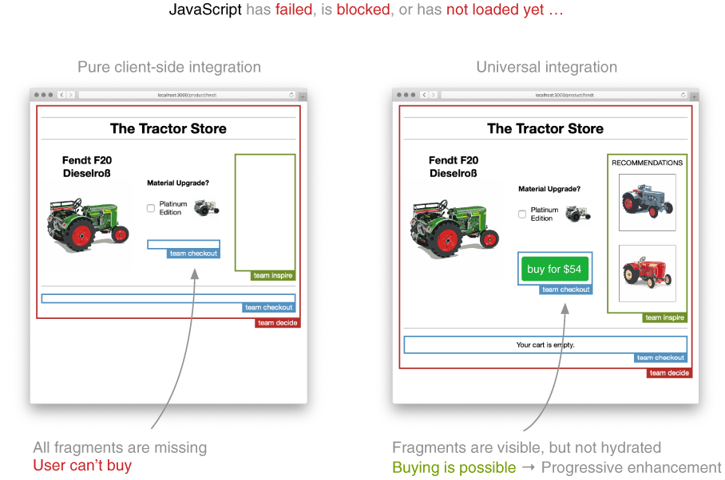
Combining server-side and client-side composition
Notes:
- The Buy button is not part of the initial markup. Client-side JavaScript renders it. While it loads, the user sees an empty spot where the Buy button will appear after a delay.
- The teams decide to switch to a hybrid integration model. Using SSI for server-side composition and also keeping the Web Components composition. This way, the first-page load can be fast, and client-side updating and communication is still possible. Let’s look at this combination.

Slide 45
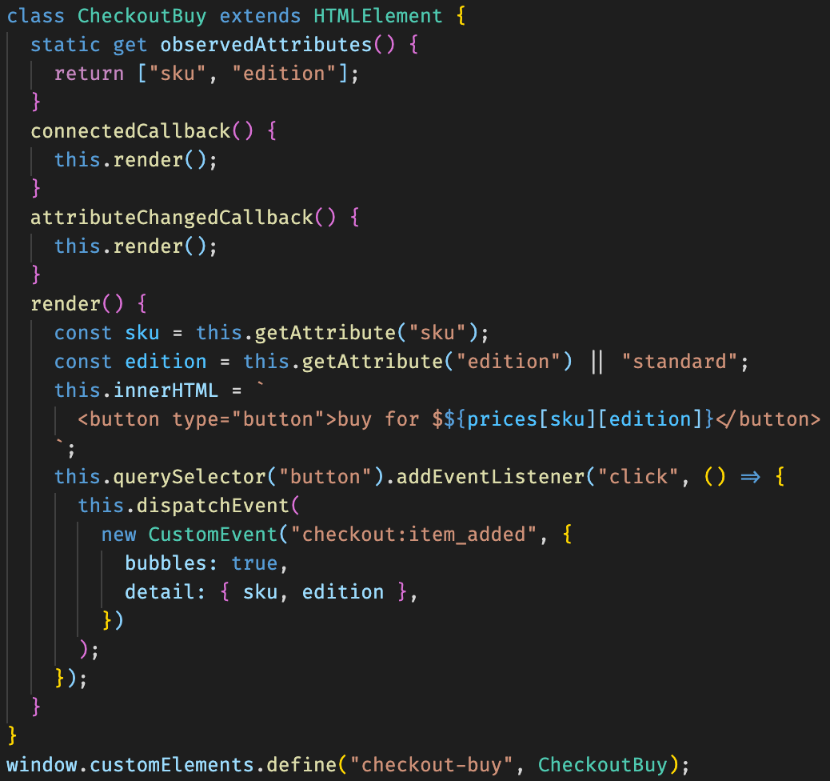
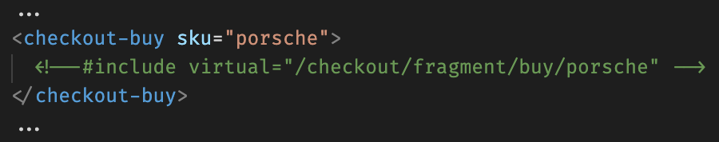
Composition via SSI and Web Commponents
Notes:
- It would be great if we could ship the button content already with the initial markup. Sadly, Web Components don’t have a standard way to render server-side
- The browser is now able to show the button instantly. The associated Custom Element code runs when the JavaScript finishes loading. It hydrates the micro frontend--making sure that the markup is correct and attaching events for further interaction.

Slide 46
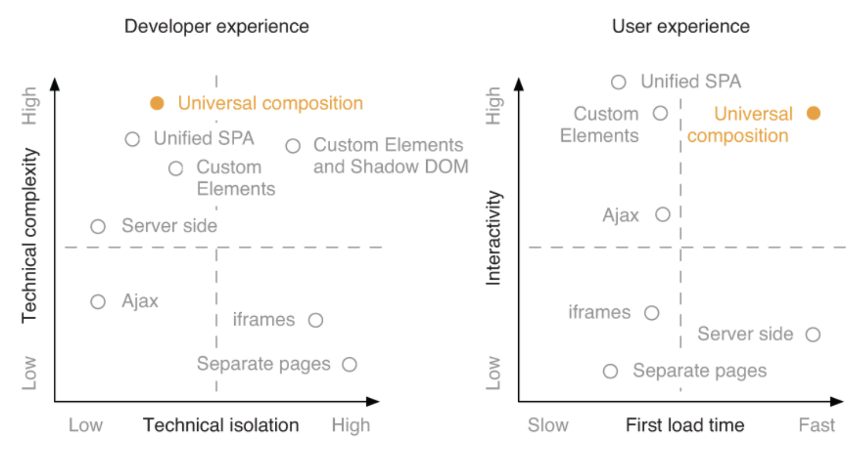
Universal composition in comparison to other integration techniques

Slide 47
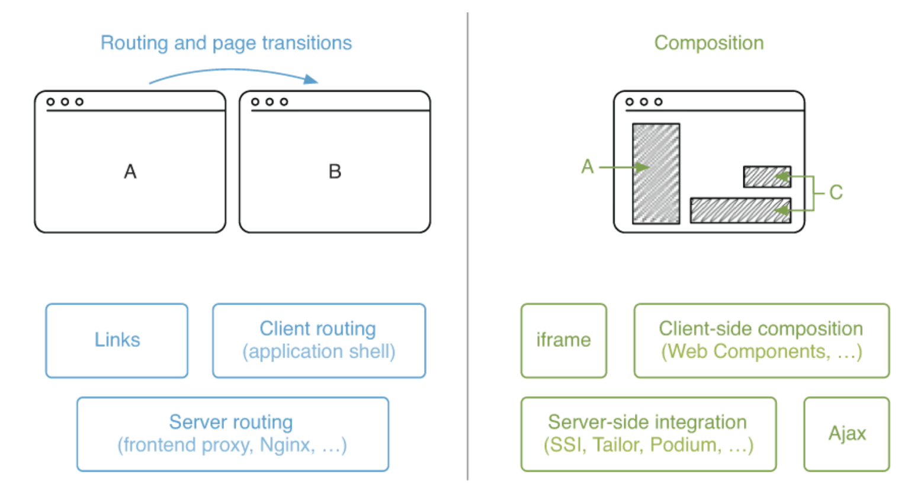
Which architecture fits your project?
Notes:
- We can group them into two categories: routing and page transition and composition

Slide 48
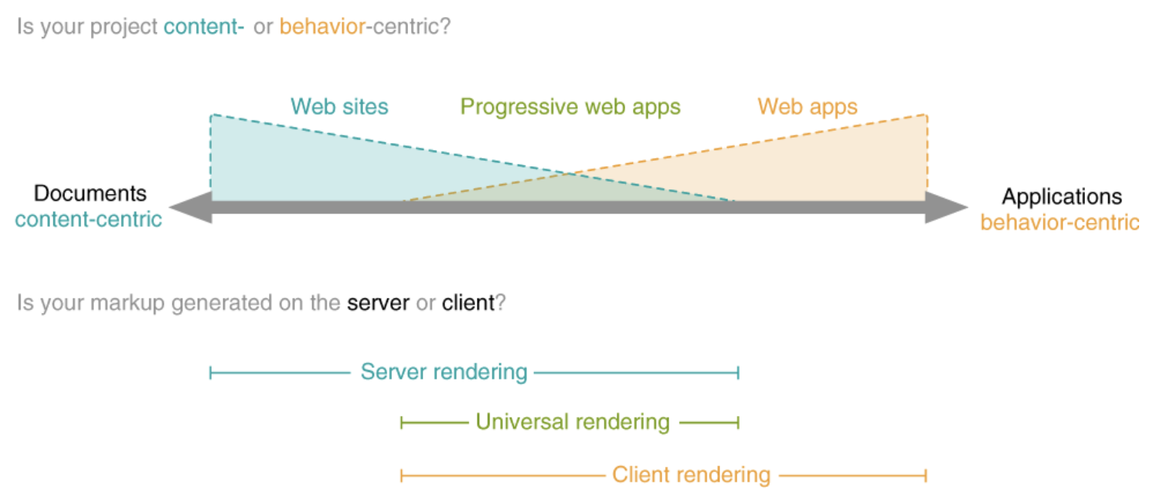
Are you building a site or an app?
Notes:
Do people come to our site to consume content, or do they want to use a specific functionality we provide?
Content-centric--Imagine a simple blog. A user can browse the list of posts and read the complete content on a dedicated article page.
Behavior-centric--Imagine an online drawing application. People can go to the site and draw beautiful sketches with their fingers and export them as an image
This scale can help you set the right priorities and select an appropriate high-level architecture
The site CodePen.io lets web developers and designers put together HTML, CSS, and JS to get a live preview in the browser
Developers use the online code editor to sketch out ideas or isolate bugs. CodePen also has an active community of people who showcase their work and share code with others
The online editor (behavior-centric) and the public catalog (document-centric). If we stripped away all behavior, the online editor would vanish. If we removed all content, the catalog would disappear, but the editor would still be there. That’s why we’d probably put CodePen in the middle of the spectrum.
Team Editor would pick a client-side approach. Team Catalog would likely go the server-side route

Slide 49
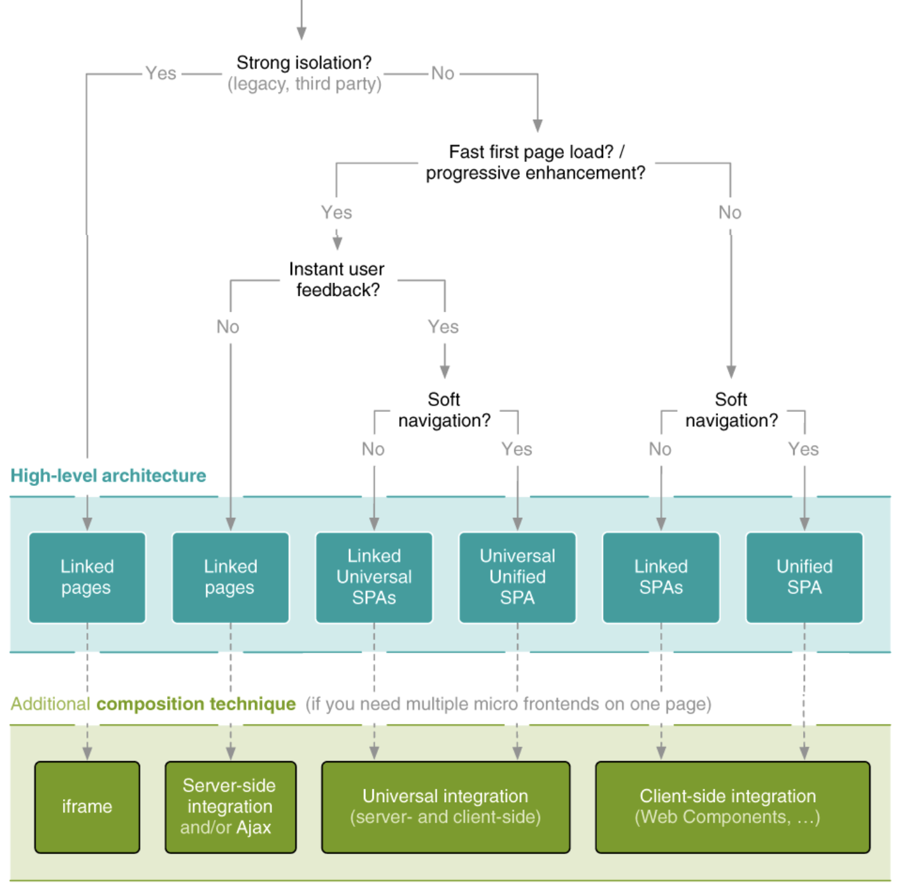
Picking the right architecture and integration technique
Notes:
Isolation and encapsulation generally lead to less unforeseen effects and reduces bugs
This is typically true if you integrate a legacy system that doesn’t respect namespacing rules and requires global state to work correctly. Another reason is security
If you want your site to rank high in search results, first-page load performance is nothing you can ignore. Search engines like Google increasingly favor fast-loading sites in their ranking

Slide 50
Showcases
AWS: client-side composition, separate pages, iframes
DAZN: client-side composition
Zalando: universal rendering
Spotify: iframes
Notes:
DAZN is an OTT platform similar to Netflix but for sports
DAZN is available worldwide in more than 200 countries and territories
Zalando
Zalando is one of the biggest publicly traded German online retailer of shoes, fashion and beauty. It has more than 50 million active users in 25 European markets.
Spotify's Music Player
Spotify uses micro-frontends in their desktop application leveraging iframes for stitching together different part of the same view. The communication between iframes is made via an event bus that decouples nicely the different part of the application allowing them to communicate without knowing who is going to listen for a message or event. Also, this approach saves a lot of time on managing the application memory because every time we change the iframe location, automatically all the objects are ready to be garbage collected.
This approach was used at the beginning for the web instance of the Spotify player, but it was abandoned due to its poor performance, and Spotify has since moved back to an SPA architecture

Slide 51
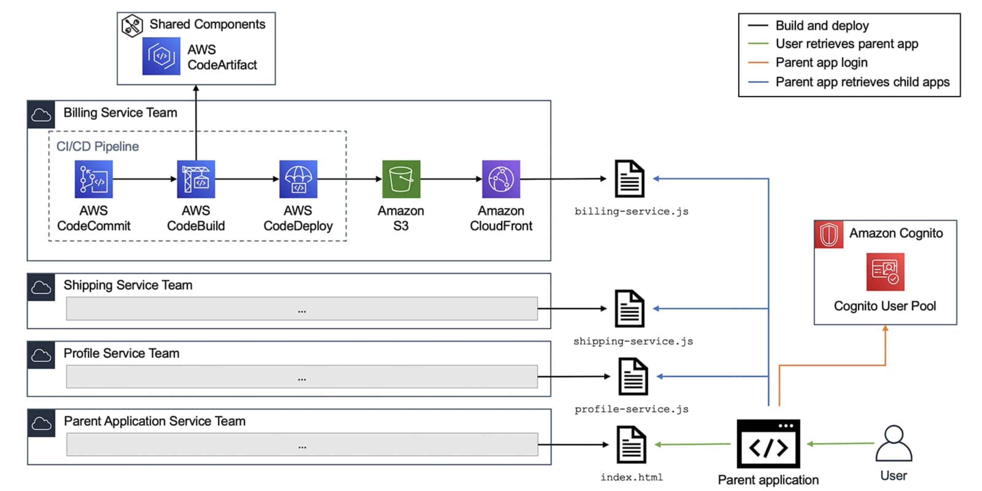
Micro-Frontends on AWS
Notes:
Importing each child application as an independent module. These modules either declares a function to render itself or is dynamically imported by the parent application (such as with web component or module federation).
They use the AWS Developer Tools and deploy the application to Amazon Simple Storage Service (S3) with Amazon CloudFront. The CI/CD pipelines use shared components such as CSS libraries, API wrappers, or custom modules stored in AWS CodeArtifact. This helps drive consistency across parent and child applications.
When you retrieve the parent application, it should prompt you to log in to an identity provider and retrieve JWTs. In this example, the identity provider is an Amazon Cognito User Pool. After a successful login, the parent application retrieves the child applications from CloudFront and renders them inside the parent application.

Slide 52
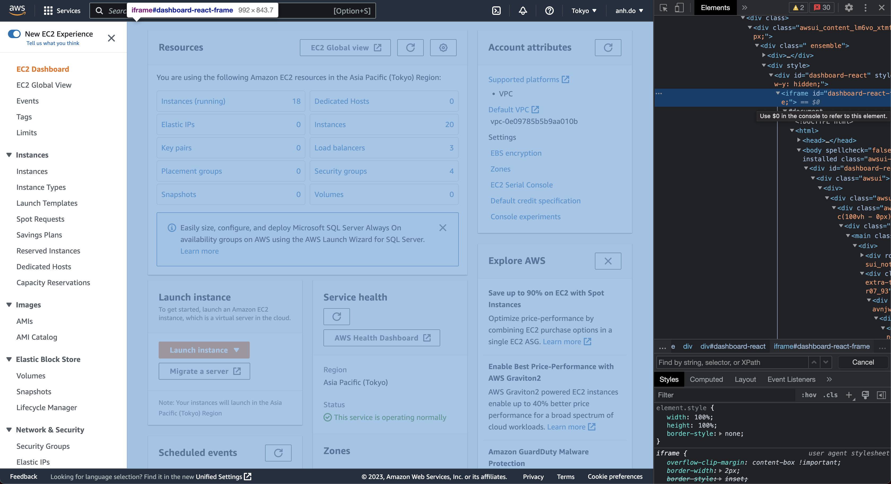
Micro-Frontends on AWS
Notes:
Header/Navigation, Footer are client-side composition
The children pages are loaded via an iframe
Dynamic loading of SPAs in the main container

Slide 53
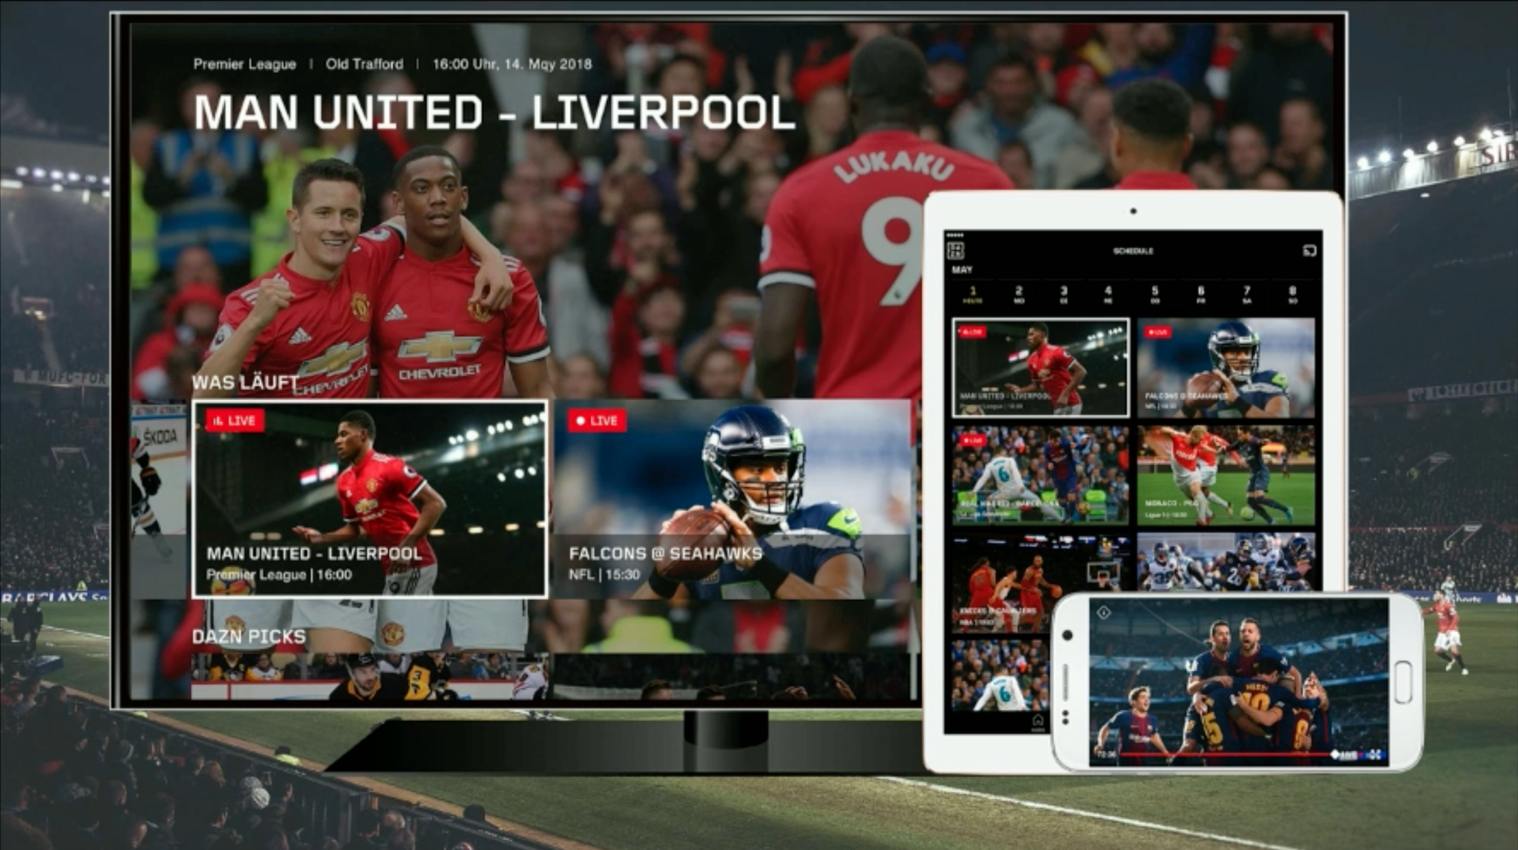
Micro-Frontends on DAZN
Dynamic loading of SPAs in main container
A Micro-Frontend represents a business domain and is autonomous
One Micro-Frontend loaded per time
No sharing between Micro-Frontends (*)
Technology agnostic
Notes:
DAZN is an OTT platform similar to Netflix but for sports
DAZN is available worldwide in more than 200 countries and territories
We have multiple teams. Some of them are working on TV. Some of them are working on web. Some of them are working on mobile
No sharing between micro-frontends:
We introduced the first shared library that is the payments shared library
If we have a new SDK for the credit card, we don’t want a MF has the latest SDK of the credit card and the other one it doesn’t
Every time that we change the shared library, those two micro-frontends have to update and deploy simultaneously.
The header and the footer are duplicated in each single micro-frontend. We are not abstracting that because the abstraction could lead to coupling
Duplication over abstraction. The wrong abstraction is way more expensive than good duplication
Technology agnostic:
Each micro-frontend can take their own path. When we proposed that, we found that the teams wanted to follow what the first team was doing

Slide 54
Additional topics
Communication patterns
Teams and boundaries
Asset loading and performance
Notes:
Communication patterns
UI communication
Parent to Fragment, Frament to Parent, Fragment to Fragment
Element attributes, Event bus (custom events, broadcast channel API)
Global context and authentication
Managing state
Frontend-backend communication
Data replication

Slide 55
References
https://learning.oreilly.com/library/view/micro-frontends-in/9781617296871/
https://learning.oreilly.com/library/view/building-micro-frontends/9781492082989/
https://micro-frontends.org/
https://martinfowler.com/articles/micro-frontends.html
https://aws.amazon.com/blogs/architecture/micro-frontend-architectures-on-aws/

Slide 56
Q&A

Slide 57
Thank you

